Slide 1



Let’s Go Serverless with Swift using Vapor
Timirah James
Cloudinary
Developer Advocate
@TimirahJ
Notes:
This talk is a continuation..

Slide 2

@TimirahJ
Notes:
The room is a lot more diverse, we’ve got some backend devs, and maybe even some devOps folks in here as well.

Slide 3


Slide 4
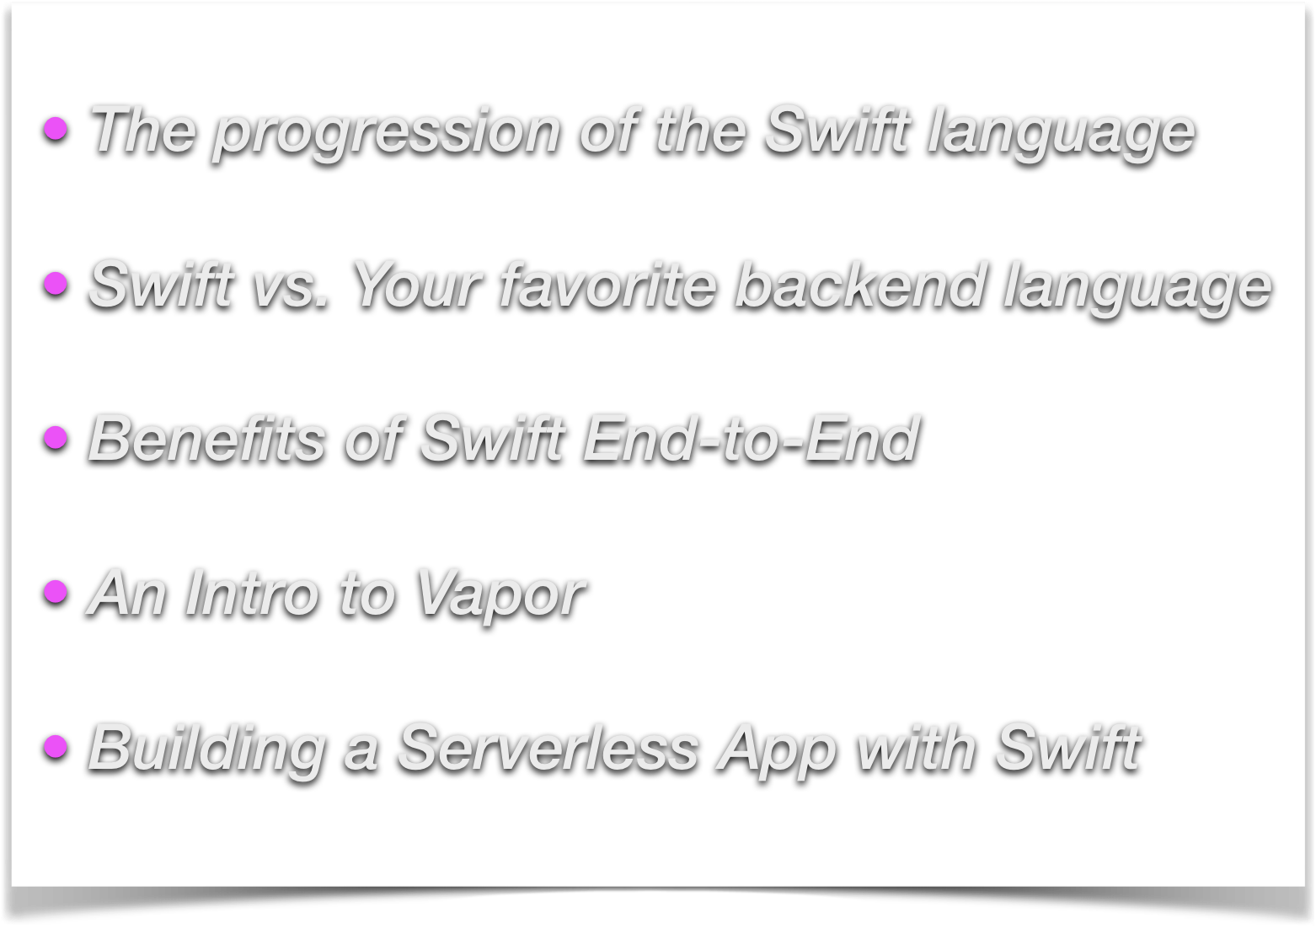
Rundown:
@TimirahJ

Slide 5
Evolution
@TimirahJ

Slide 6

2014… Swift was born!!!

Slide 7
What made it so sexy?
Catchy syntax for MOST programmers (JavaScript, Python, C++)
Fair transition from Obj-C
Prevents Huge Memory Leaks
Faster Performance
@TimirahJ
Notes:
Syntax was easier to read (which is especially important for a new language). No semicolons or excess square brackets or asterisks for pointers.

Slide 8

In 2015…
2015…Open Sourced Swift!!!
@TimirahJ
Notes:
What did that mean?? Gave developers more influence and control.

Slide 9
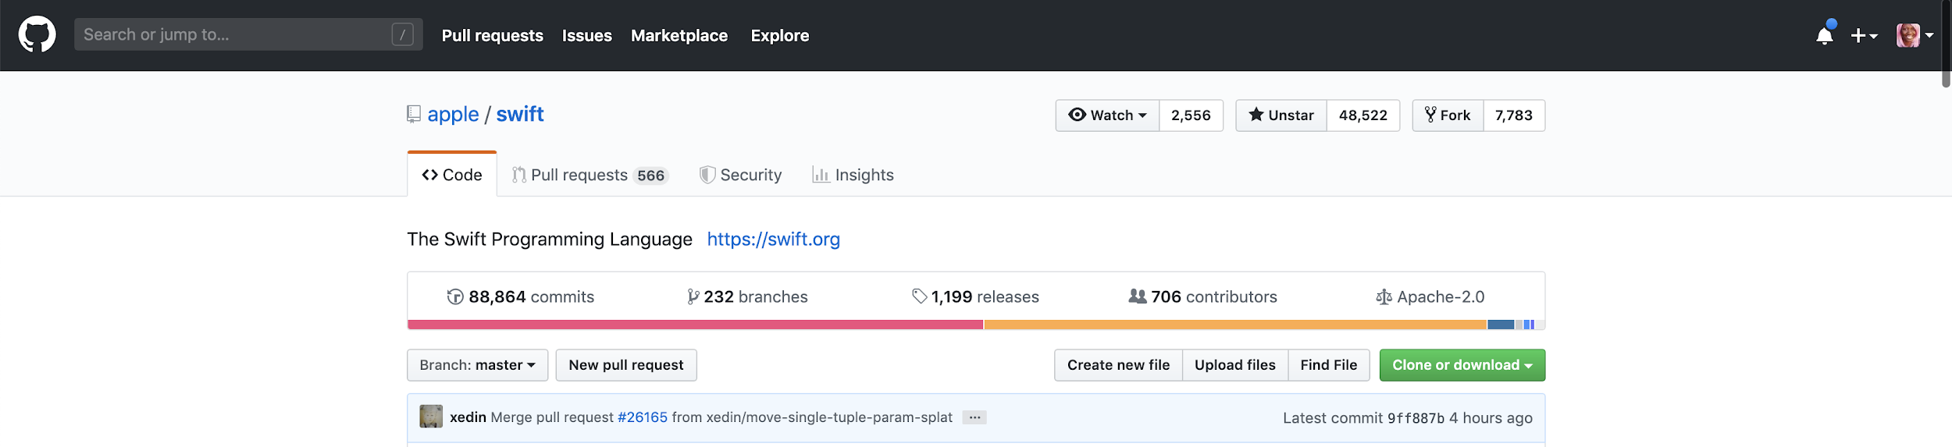
Almost 90k commits
Over 700 contributors
@TimirahJ

Slide 10
Syntax Evolution
2015
2016
2017
Swift 2+
Swift 3+
Swift 4+
guard / guard let
Function parameter labels
Codable Protocol
Protocol Extensions
Attributes for C functions
Conditional Conformances
@TimirahJ
Notes:
Safety, Syntax, Speed +++

Slide 11
In 2019, Swift 5+
ABI Stability
Application Binary Interface
@TimirahJ
Notes:
Binary equivalent of an API
The solution so far has been to ship iOS apps that use Swift with the Swift dynamic binary itself. Instead of connecting to the OS, every app links to their own specific version of Swift!
The main advantage is that app developers can develop apps with Swift, while Swift is actively being developed, without running the risk of ABI incompatibility. Changes to Swift can be distributed without updating iOS.

Slide 12

@TimirahJ
Notes:
General overall issue of King Apple: You must build with Apple products, for Apple products.

Slide 13

Nahh.
@TimirahJ

Slide 14

Swift vs. Your Favorite Backend Language
@TimirahJ

Slide 15
What’s your priority as a dev?
@TimirahJ

Slide 16
Performance
Swift > Node.JS
Swift > Ruby
https://benchmarksgame-team.pages.debian.net/benchmarksgame/
Swift > Java
@TimirahJ

Slide 17

Why Server-Side Swift?..
Enables you to use Swift to create RESTful APIs to build your own backend service!
Gives you full control over handling and transferring data from applications to a server, using an API.
Creating full web applications using Swift and Xcode
Full-Stack Swift!!
Notes:
Works just like any web API, you can use Swift on both ends (for web apps and mobile apps)

Slide 18

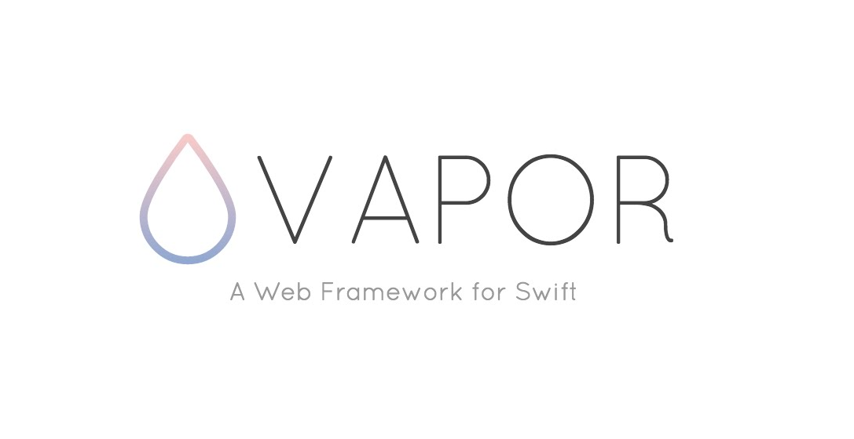


@TimirahJ
Notes:
SwiftEngine is the first turn-key serverless Swift platform for app development, creators are instructors from USC.

Slide 19


Let’s Get Started!

Slide 20


Large responsive community
Speed
Easy to use
Notes:
Vapor alone has close to 17,000 stars on Github. Vapor is currently the most popular framework due to its community, speed, and ease of use!
Vapor is also the only framework that is written purely in Swift; Focuses on keeping its APIs simple, readable, and keeping the naming and other conventions (with lots of protocols) in line with the language.

Slide 21



What can Vapor Do?
Data
Data
Notes:
Works just like any web API, you can use Vapor on both ends (for web apps and mobile apps)

Slide 22

A tool used for building ORMs (object relational mapping) tool that handles database interactions.
Notes:
No need to remember an SQL query
Works great with Swift
Can integrate with MySQL, SQLite, & MongoDB

Slide 23

Leaf is a templating library that allows us to make HTML-like pages and render them using Vapor.
Notes:
Has a Swift-like syntax
You can use this to generate a front-end website, and continue designing it with CSS however you’d like

Slide 24
Let’s Try It Out!
(Vapor Demo)
https://github.com/timirahj/Server-Side-Swift-using-Vapor-Talk
Notes:
>> Go to installation site (vapor.codes) for show, then start demo! <<
Run ‘vapor new FirstWebApp’, then ‘vapor build’, then ‘vapor run’
Vapor Xcode -y to open Xcode

Slide 25
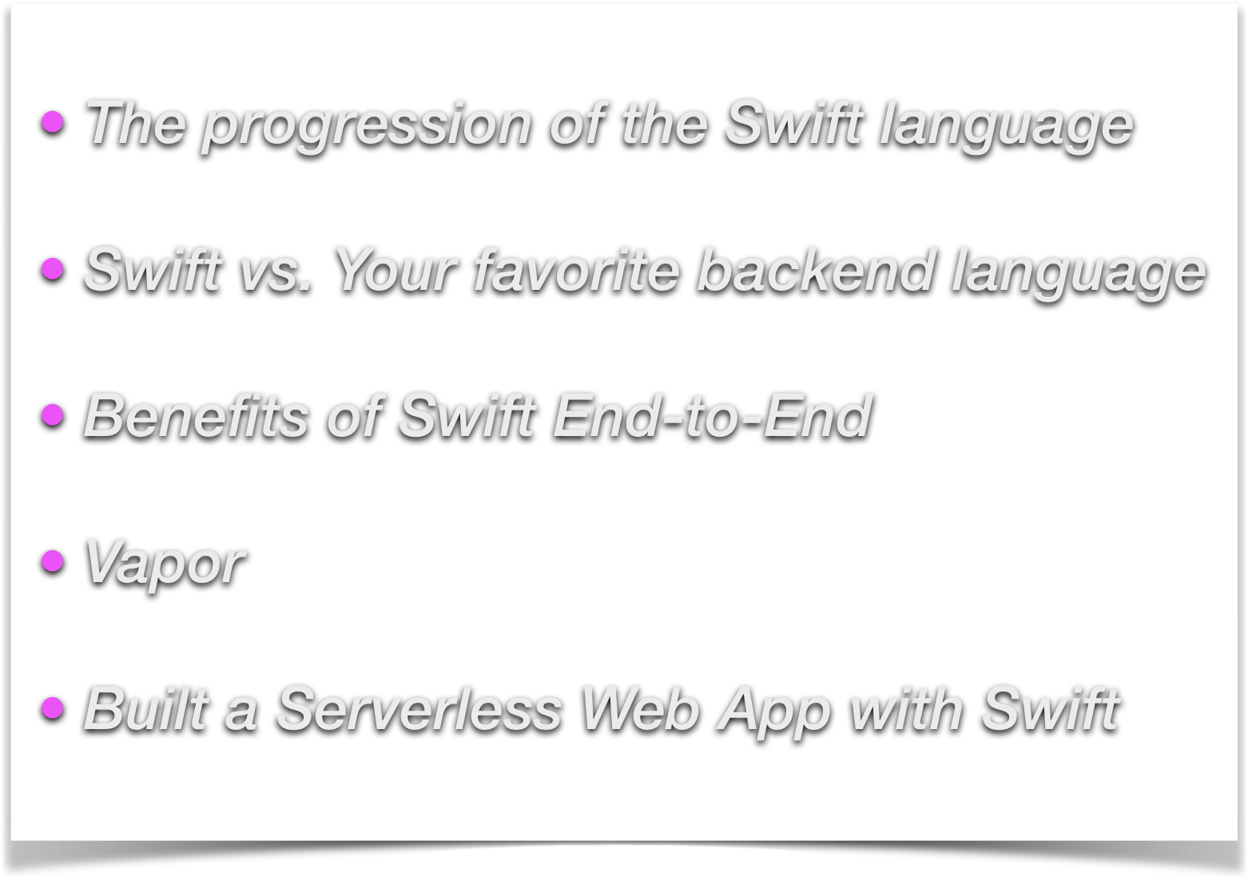
Review

Slide 26
Future & Potential
@TimirahJ
Notes:
Easy to Read
Open Source
Safe / Type-Safe
Server-side
Microservices & Containerization
Containerization — now you can build containerized applications on platforms like AWS
OpenStack’s SwiftStack Architecture: you can run Swift servers on OpenStack

Slide 27
Resources
Documentation: vapor.codes
Video Courses: Vapor Academy
Repo: https://github.com/vapor/vapor
@TimirahJ

Slide 28
Them: So what kinds of things to you build?..
Swift Devs: YES.
@TimirahJ

Slide 29
Thank You!
Tweet Me!
@TimirahJ
timirah@cloudinary.com
GitHub.com/timirahj

